Slide 1
Method development
in
computational biology
René Staritzbichler
AG Hildebrand
Institut für Biophysik und Medizinische Physik (IMBP)
Universität Leipzig

Slide 2
cv
Diploma in Physics at University Hamburg / Deutsches Elektronen Synchrotron (DESY)
PhD in Physics at Max Planck Institute of Biophysics
Postdoc
with Jens Meiler at Vanderbilt University
Max Planck Institute of Biophysics
with Ugur Sahin at BIONTECH
CEO / Founder at Immuthera GmbH
Postdoc with Peter Hildebrand at Institute of Biophysics and Medical Physics
http://staritzbichler.com/rene.html

Slide 3
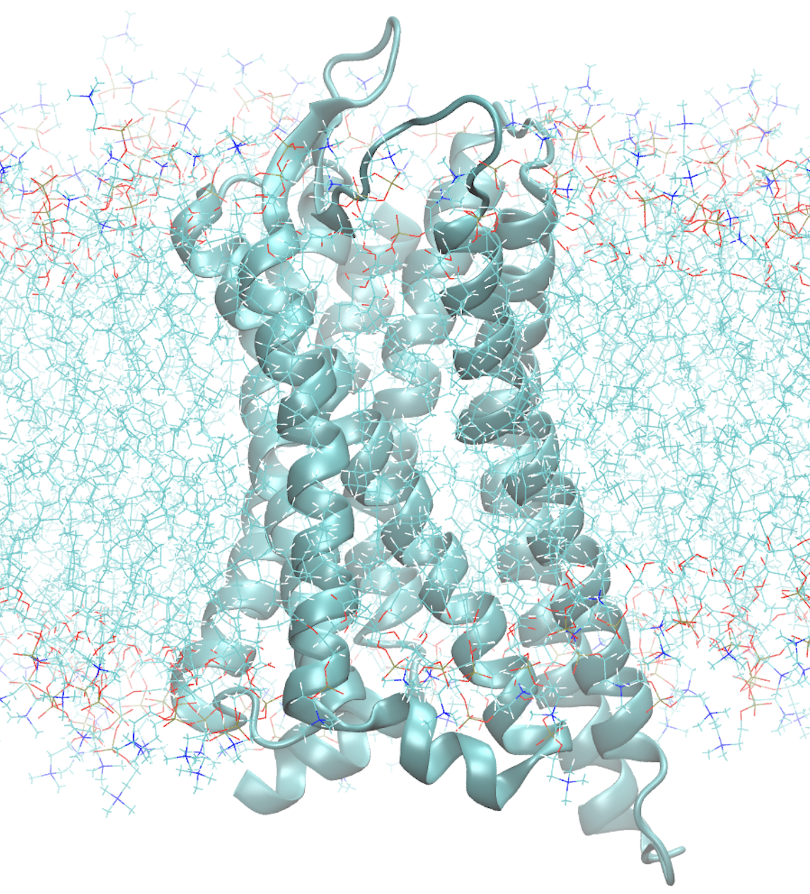
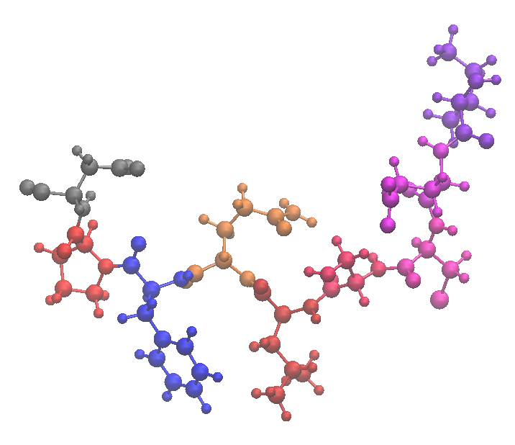
Molecular biology
Methods
Dynamics
Binding
Design
Machines of the cell
Proteins
Receptors:
GPCR
Immune receptors
Biomedical application
Side effect reduction
Marker
Therapeutics

Slide 4
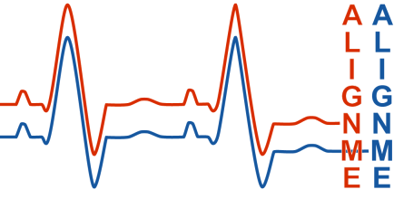
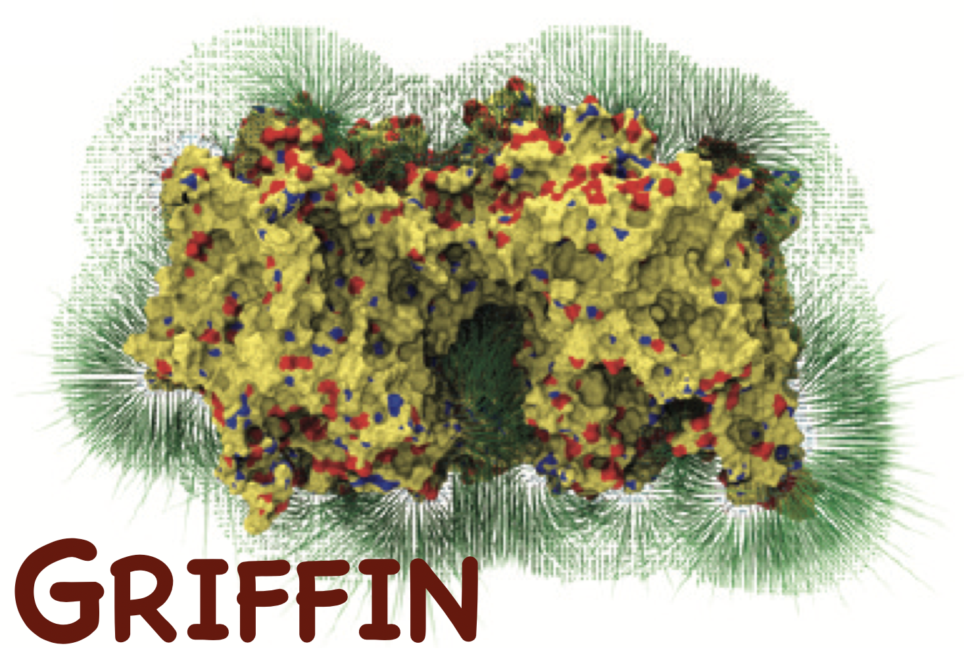
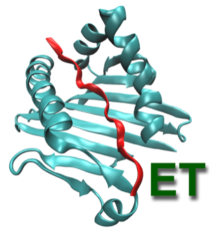
Key achievements
Medical | Software (C++) | Webserver (flask,js)
New laboratory diagnostic method using Raman spectroscopy (patent pending) Design of an epilepsy drug (currently tested in mice) collaboration with Charité, Uni Innsbruck and Company
(cgi/perl)
(python)
Epitope Threader
bcl::fold / bcl::em-fold
Voronoia

Slide 5
Epitope Threader
Binding

Slide 6
Outline
Webserver
#1 MDsrv
#2 AlignMe
#3 MutantX
#4 ProteinPrompt
Software
#5 bcl::fold & bcl::em-fold
#6 EpitopeThreader
#7 SmoothT
#8 Griffin

Slide 7
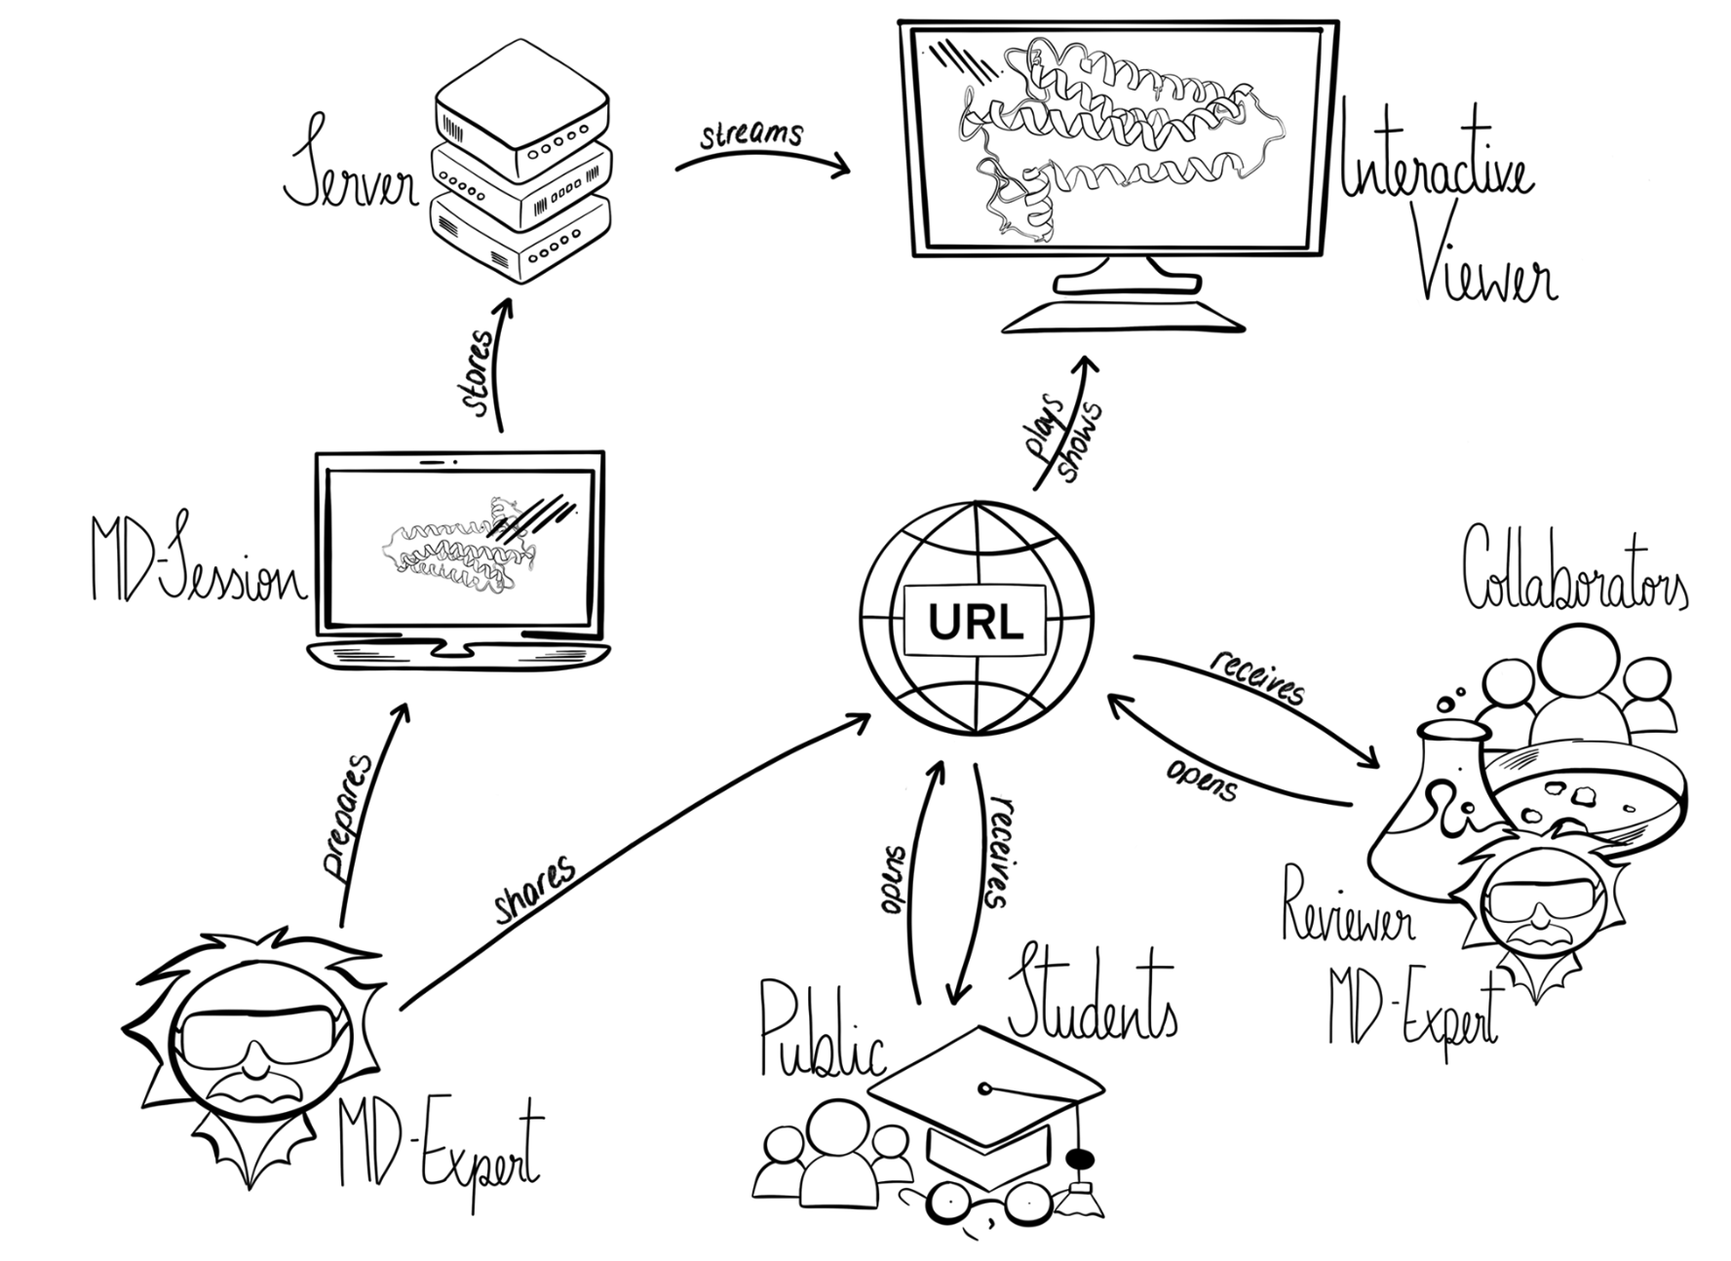
#1
Webserver
@Uni Leipzig
Sharing simulations
MDsrv: visual sharing and analysis of molecular dynamics simulations.
Kampfrath M, Staritzbichler R, Hernández GP, Rose AS, Tiemann JKS, Scheuermann G, Wiegreffe D, Hildebrand PW.
Nucleic Acids Res. 2022

Slide 8
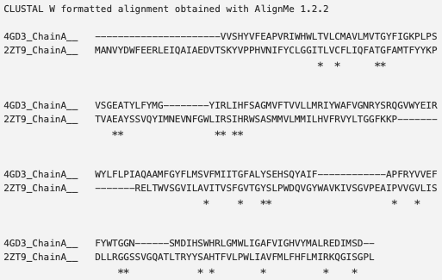
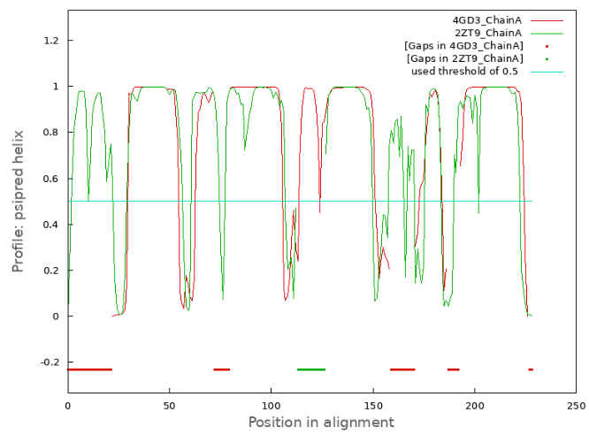
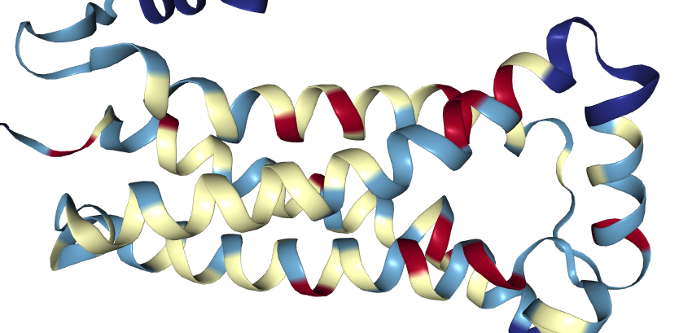
#2
Webserver / software
@MPI Biophysik
Alignment of proteins lacking sequence similarity
Similarity of biochemical and predicted profiles
Advanced gap penalties for e.g. non-breaking of helices
Expert knowledge: user defined anchors (multiple, varying strength)
Forward alignment for 3D visualisation to MutantX
AlignMe--a membrane protein sequence alignment web server.
Stamm M, Staritzbichler R, Khafizov K, Forrest LR.
Nucleic Acids Res. 2014
AlignMe: an update of the web server for alignment of membrane protein sequences.
Staritzbichler R, Yaklich E, Sarti E, Ristic N, Hildebrand PW, Forrest LR.
Nucleic Acids Res. 2022

Slide 9
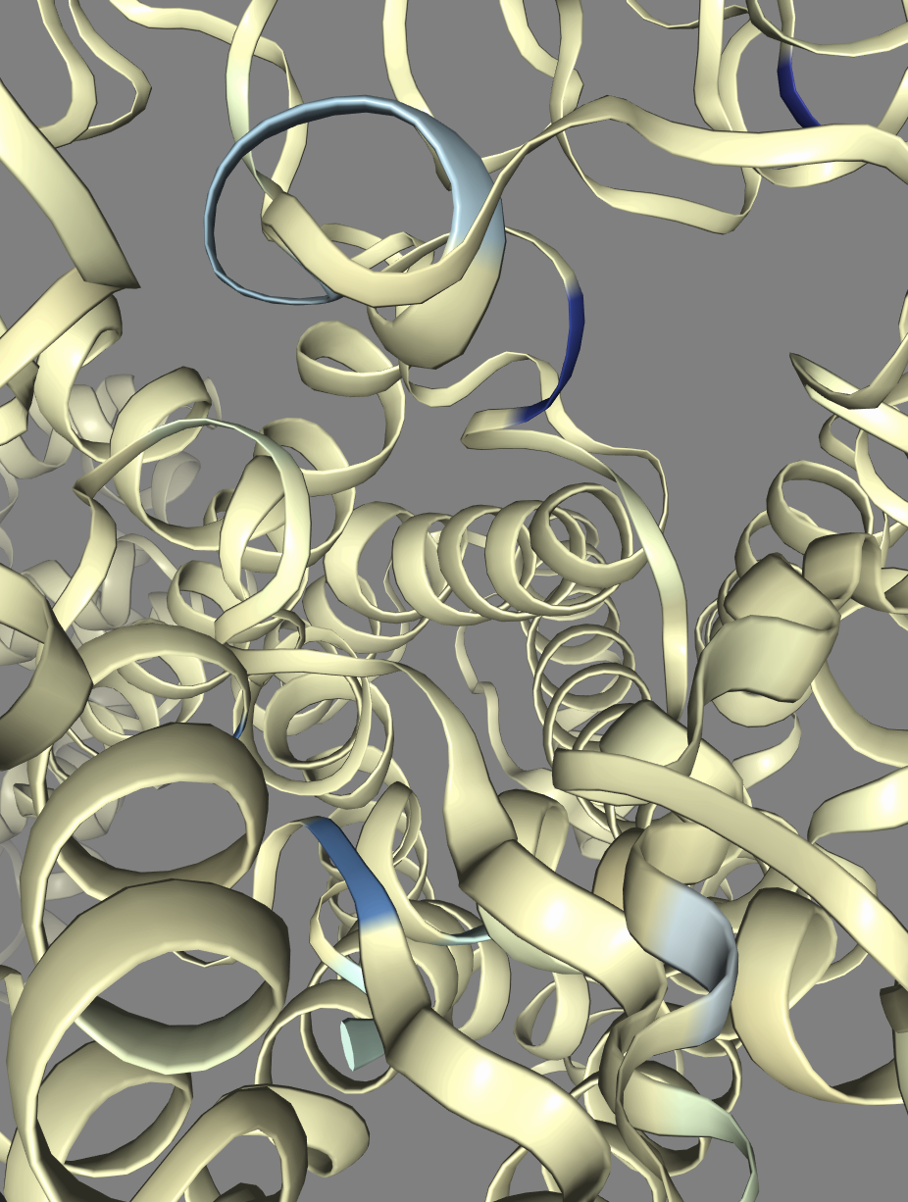
#3
Webserver
@Uni Leipzig
The mutation explorer
Mutations :: Rosetta design
User interface: „A:G13L“
Sequencing data
Alignments
https://proteinformatics.uni-leipzig.de/mutation_explorer_beta/mutantX

Slide 10
#4
Webserver / software
@Immuthera GmbH
Predicting protein binding partners from sequence
Unexpected binding may cause side-effects
Scans entire human proteome in <1 minute (27223 sequences)
2 implementations (similar accuracy):
Random forest (scikit)
Graph neural networks (pytorch)
ProteinPrompt: a webserver for predicting protein-protein interactions
Sebastian Canzler, Markus Fischer, David Ulbricht, Nikola Ristic, Peter W. Hildebrand, René Staritzbichler
bioRxiv 2021.09.03.458859; doi: https://doi.org/10.1101/2021.09.03.458859

Slide 11
Random forest
Rather simple approach, yet gold standard
Ensemble decision trees with bootstrap aggregation
Sequences must be transformed to feature vector of constant size ‚manually‘
Autocorrelation of 7 amino acid scales

Slide 12
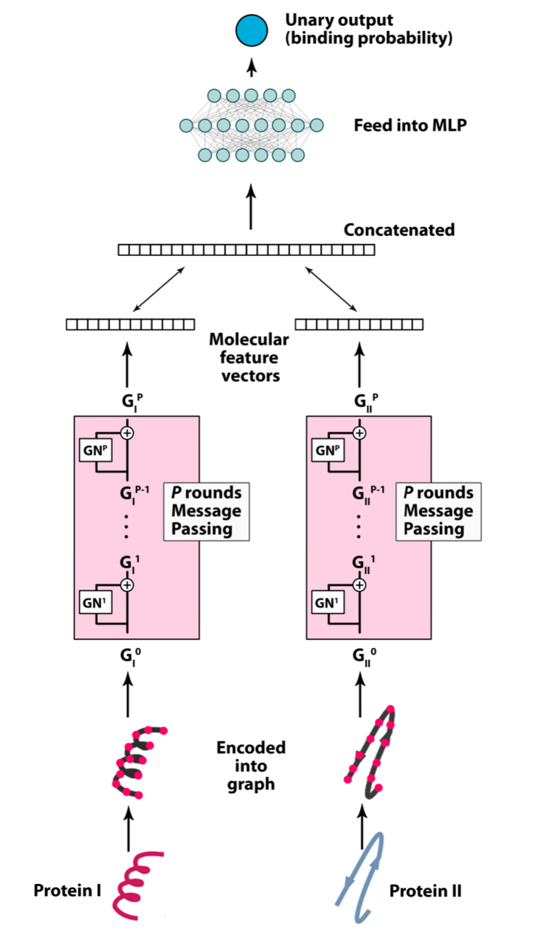
Graph neural network
Can handle input data of varying size!
Optimises feature vector transformation and prediction MLP commonly

Slide 13
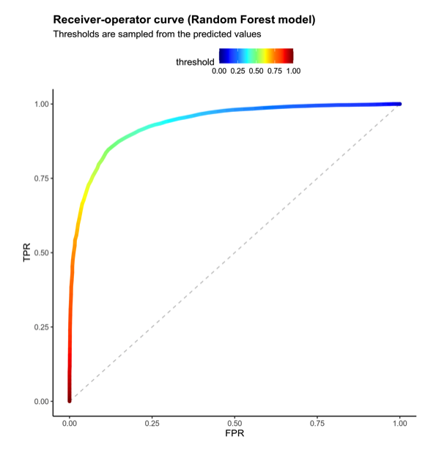
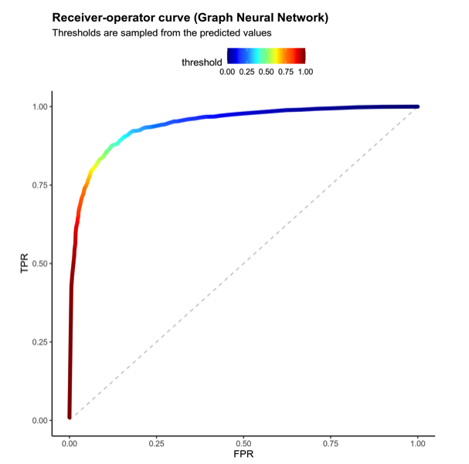
Performance
Plots were made with prettyPROC R-package

Slide 14
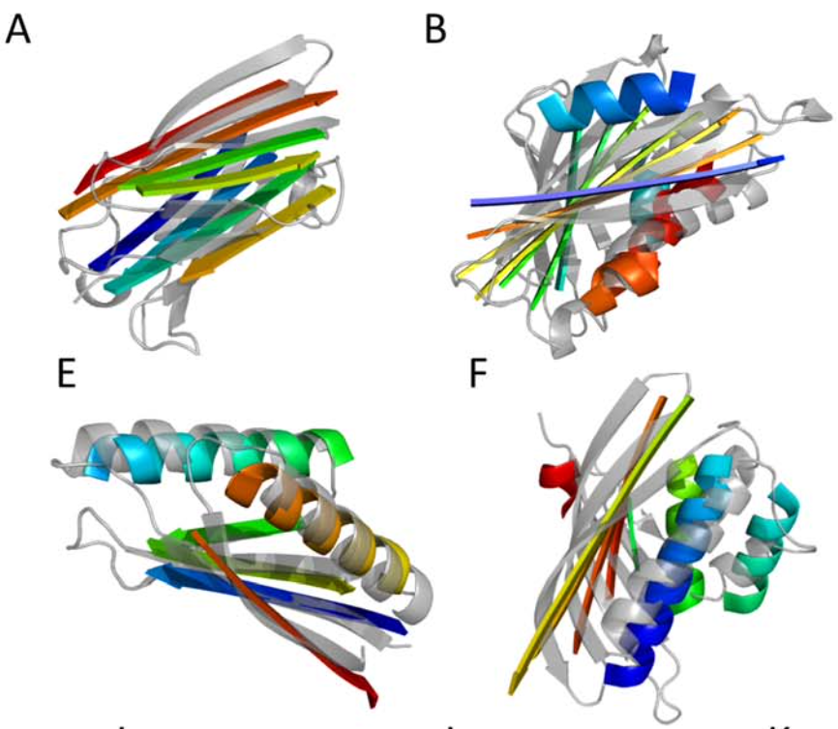
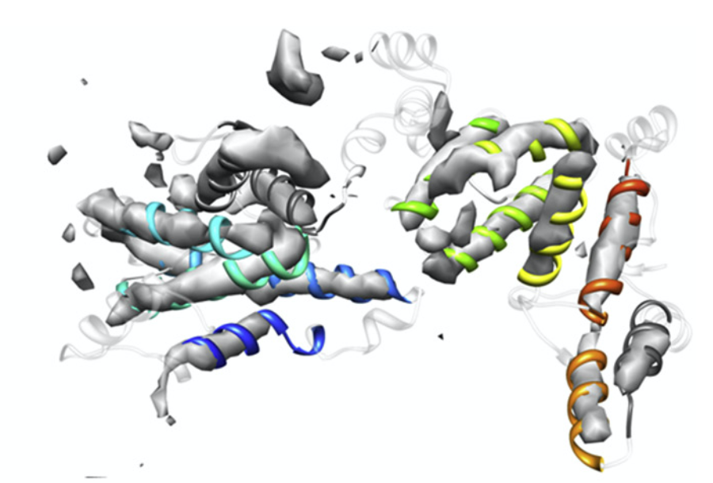
#5
Software
bcl::fold
bcl::em-fold
@Meilerlab
Structure elucidation
Similar approach as Rosetta
Monte Carlo
Statistical potentials
Secondary structure elements
Overcoming Rosetta’s size limitation
Fold into cryo EM density map

Slide 15
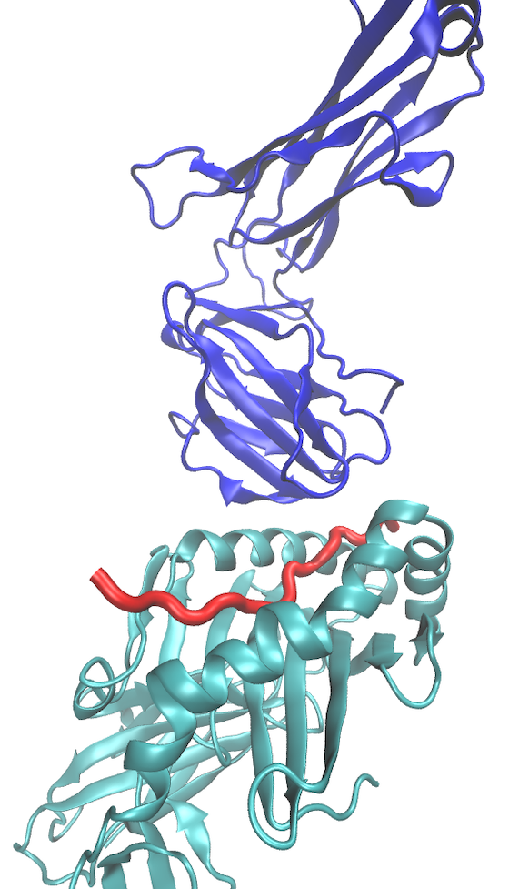
#6
Software
@BIONTECH
Predicting immune reactions
Predicting vaccines
Highly conserved structures
MHC: cyan
Epitope: red
TCR: blue
Ideal for threading (extremely fast)

Slide 16
#7
Software
@Uni Leipzig
Transition pathways
Realistic movies
Simple transition pathway construction
Input: ensemble of models & energies
Output: pathway with lowest energy barrier (subset of ensemble)
Enhanced sampling: start MD from each node of path
Link between MC and MD

Slide 17
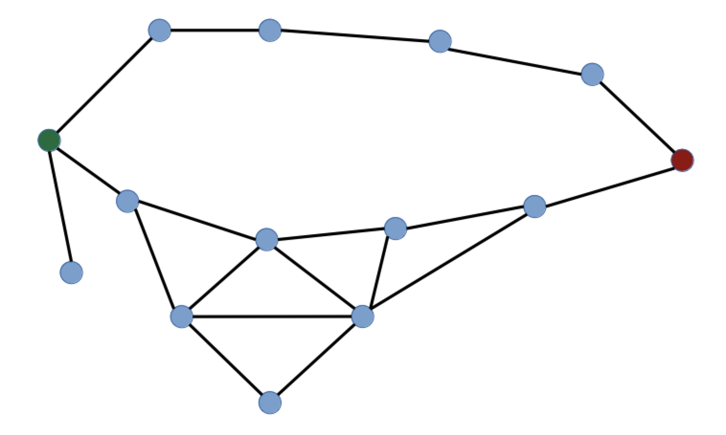
Path construction
Forward graph construction
Find all pairs of similar models
Backward path selection
Minimum energy barrier
Minimum energy integral
Node: model with energy
Edge: RMSD < threshold
Starting model
Final model
Live show

Slide 18
Path from MD
MD spends most time with local fluctuations
The movie summarises many long simulations

Slide 19
#8
Software
@MPI Biophysik
The implicit protein force field
Molecular dynamics is very accurate yet limited in sampling
Griffin is precalulating a potential protein force field
Atomic detail (highly accurate)
Precalculated on grid (fast but static)
GRIFFIN: A versatile methodology for optimization of protein-lipid interfaces for membrane protein simulations.
Staritzbichler R, Anselmi C, Forrest LR, Faraldo-Gómez JD.
J Chem Theory Comput. 2011

Slide 20
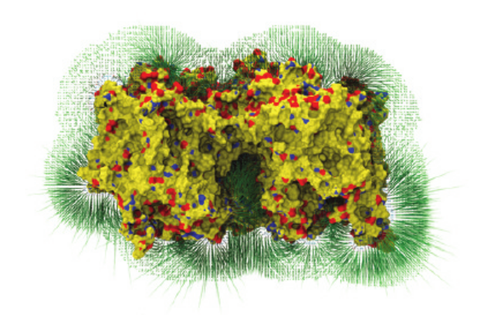
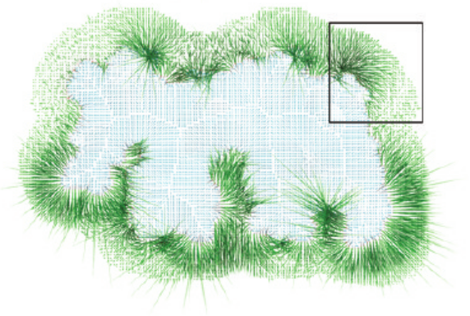
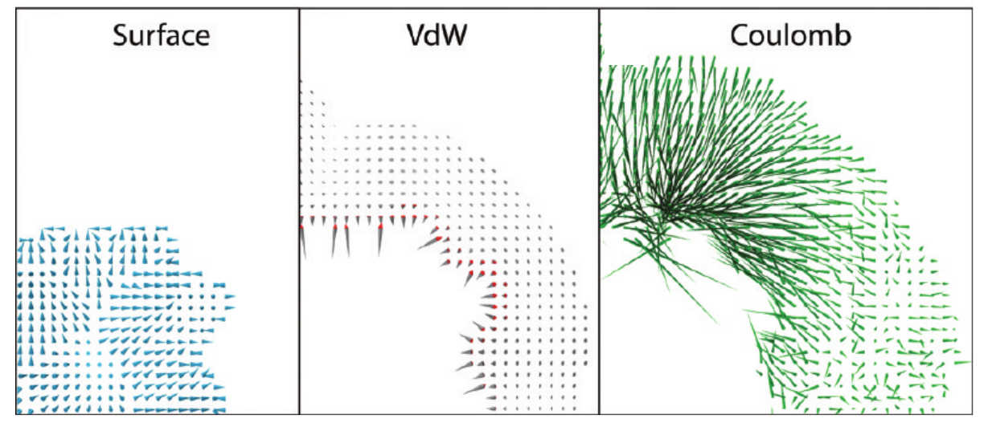
Force grid
Precalculate forces acting on dummy atom located at grid point

Slide 21
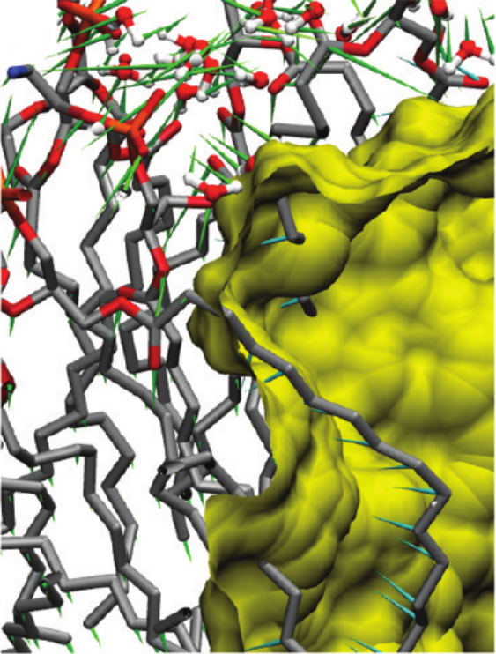
Resulting forces
Inside molecule volume: surface force
Outside: Coulomb and van der Waals

Slide 22
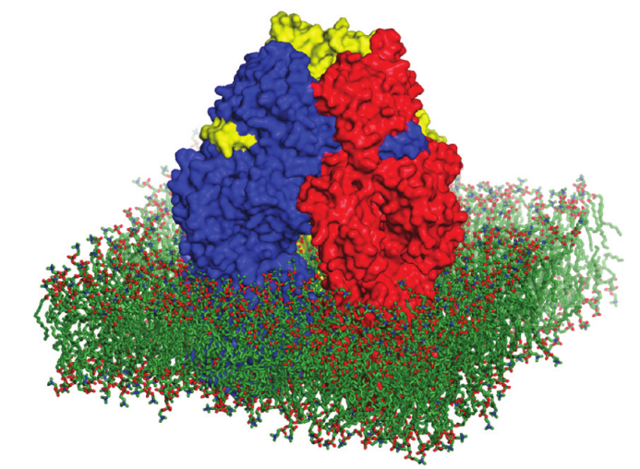
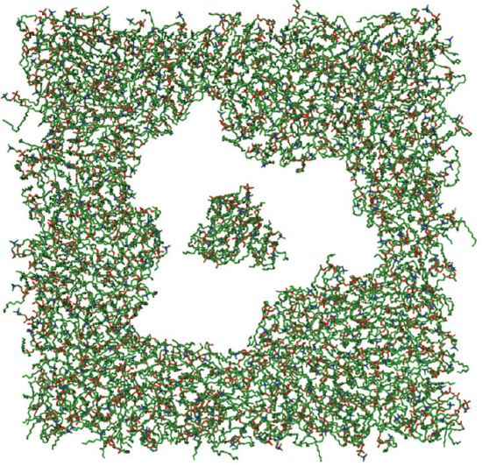
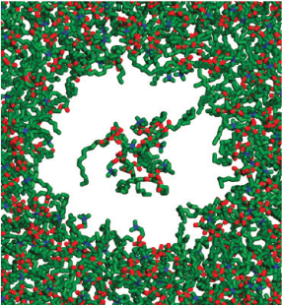
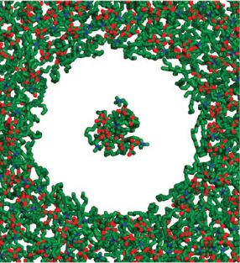
The ‚ghost‘ in action
I:
II:

Slide 23
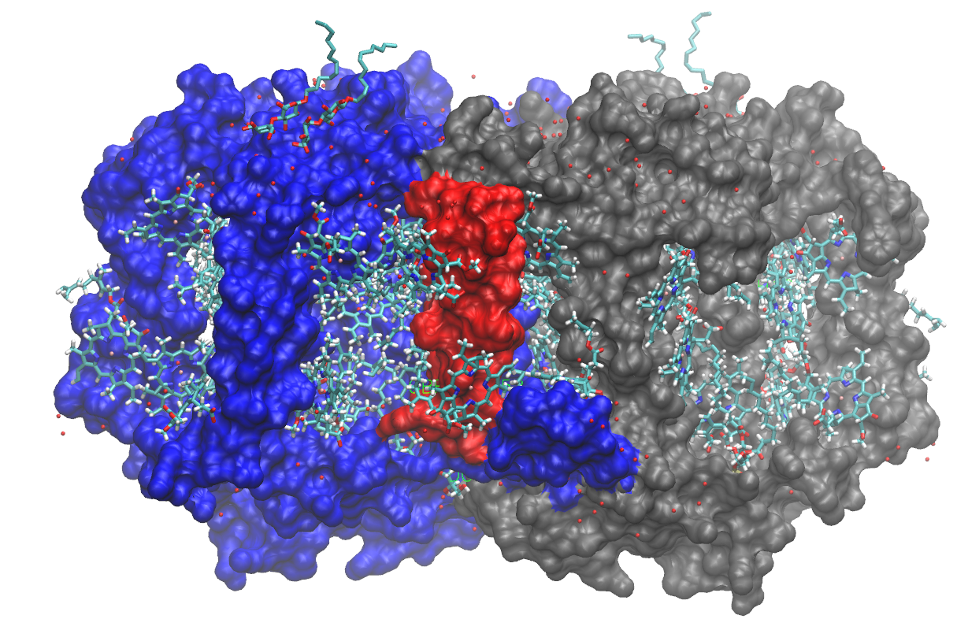
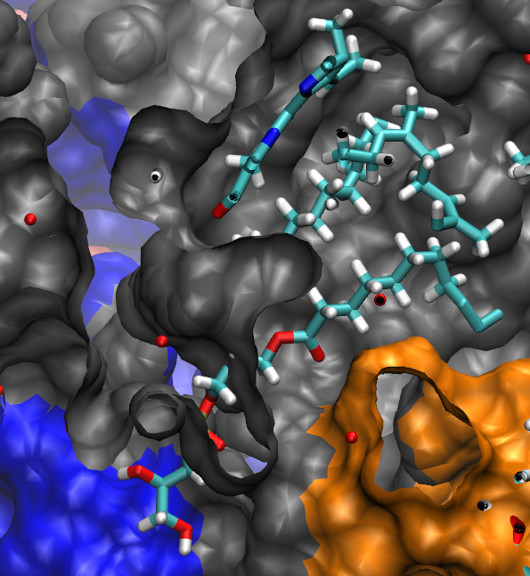
Bacterial photosystem
Modeling of complex topology with massive clashes.

Slide 24
C++ concepts
Grid points: polymorphism
Link to MD:
High RAM demand => fork daemon
Inter process communication (ipc.h)
Parallelization (mpi.h)
Molecule-atom force-field
shared_ptr<GridPoint> gp = new SurfaceForce(implicit_mols, pos);
vector3N force = gp->Force(explicit_atom);

Slide 25
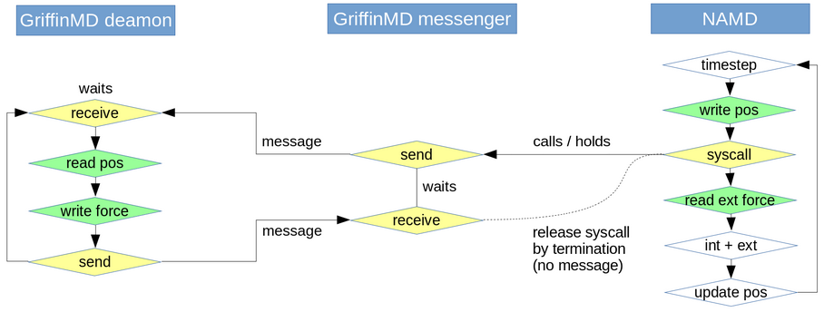
Workflow
Implicit
Explicit

Slide 26
Explicit vs implicit
Split
static: implicit
dynamic: explicit
Flexible choice
even within one molecule

Slide 27
Griffin outlook
Rigid body dynamics
Dynamics of large assemblies (e.g. viral capsids)
Protein-protein force-field (5D/6D grid)
SQL instead of RAM
Monte Carlo
Binding of small molecules (Docking)

Slide 28
Acknowledgments
AlignMe
Kamil Khafizov
Markus Stamm
Edoardo Sarti
Lucy Forrest
Griffin
Lucy Forrest
José Faraldo-Gómez
ProteinPrompt
Sebastian Canzler
Markus Fischer
Nikola Ristic
Peter Hildebrand
EpitopeThreader
Ugur Sahin
MDsrv
Michelle Kampfrath
Daniel Wiegreffe
Guillermo Pérez Hernández
Johanna Tiemann
Alex Rose
Gerik Scheuermann
Peter Hildebrand
bcl::fold & bcl::em-fold
Nils Wötzel
Mert Karaks
Jens Meiler
‚Lone wolf’ projects
Epitope Threader
(Prototype)

Slide 30
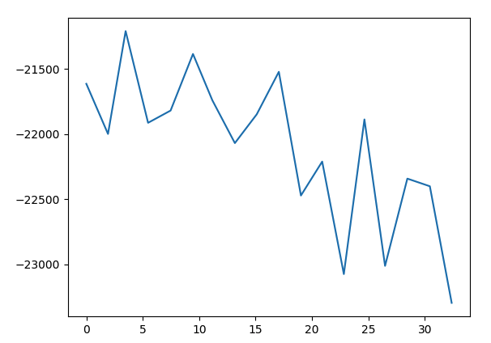
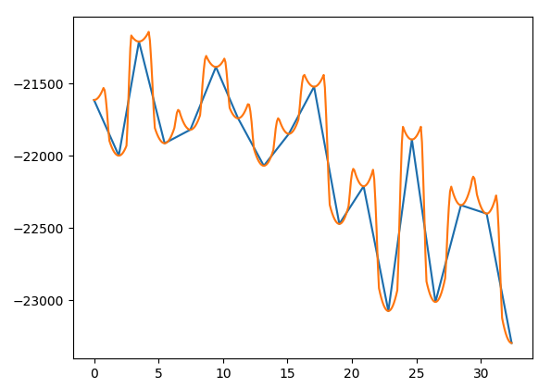
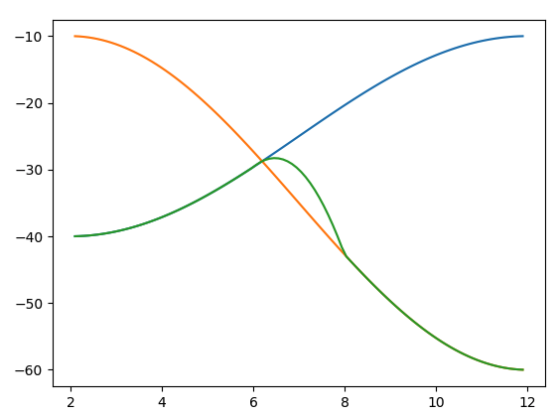
Energy profile
Path is basic energy profile (blue)
Each model represents local minimum
Minimum can be estimated by simple well
Superimposing wells returns simple estimation of energy profile (orange)

Slide 31
SmoothT outlook
Webserver
Upload an ensemble of models
Define a RMSD threshold, start and end point
Displays movies of pathways

Slide 32
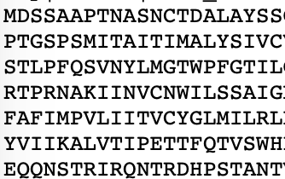
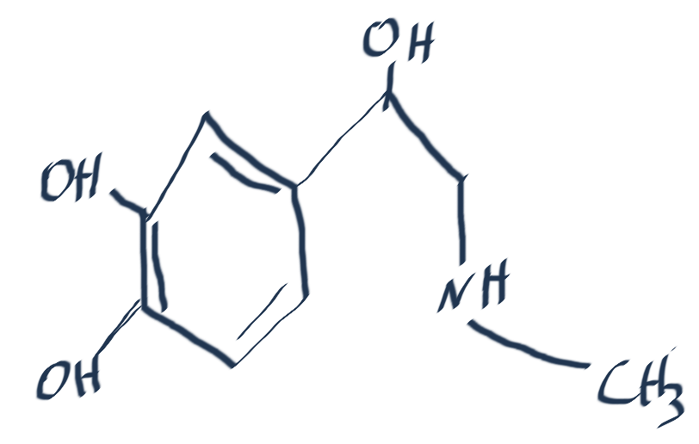
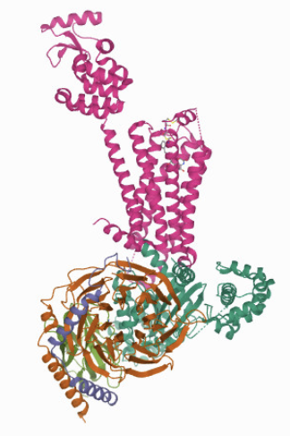
AlignMe
ProteinPrompt
ProteinPrompt3D
Griffin
MD
Raman
IR
VIS
MS
NMR
GenSeq
MutantX
MDsrv
LearnIT
Clinical
Diagnosis
Characterization
History
Graphical
Report
Adverse
effects
Marker
Diagnosis
Patient

